Slide 1

Appointment Scheduling System
Database Development Using PL/SQL
Student: Shema Christian
Course: INSY 8311 – Database Development with PL/SQL
Date: May 16, 2025

Slide 2
Introduction & Problem Statement
The Appointment Scheduling System is developed to manage patient bookings efficiently at the dental clinic. It handles appointments, cancellations, and timely reminders, improving operational workflow.
Problem Statement
Manual scheduling creates booking conflicts and data inconsistencies.
Inefficient cancellation tracking causes potential revenue loss.
Currently, appointment management involves manual tracking which can lead to errors, missed bookings, and patient dissatisfaction. The system automates these processes, reducing human error and improving service quality.
Reminders are not systematically managed, increasing no-show rates.
The proposed system aims to automate these areas for enhanced reliability and patient experience.

Slide 3
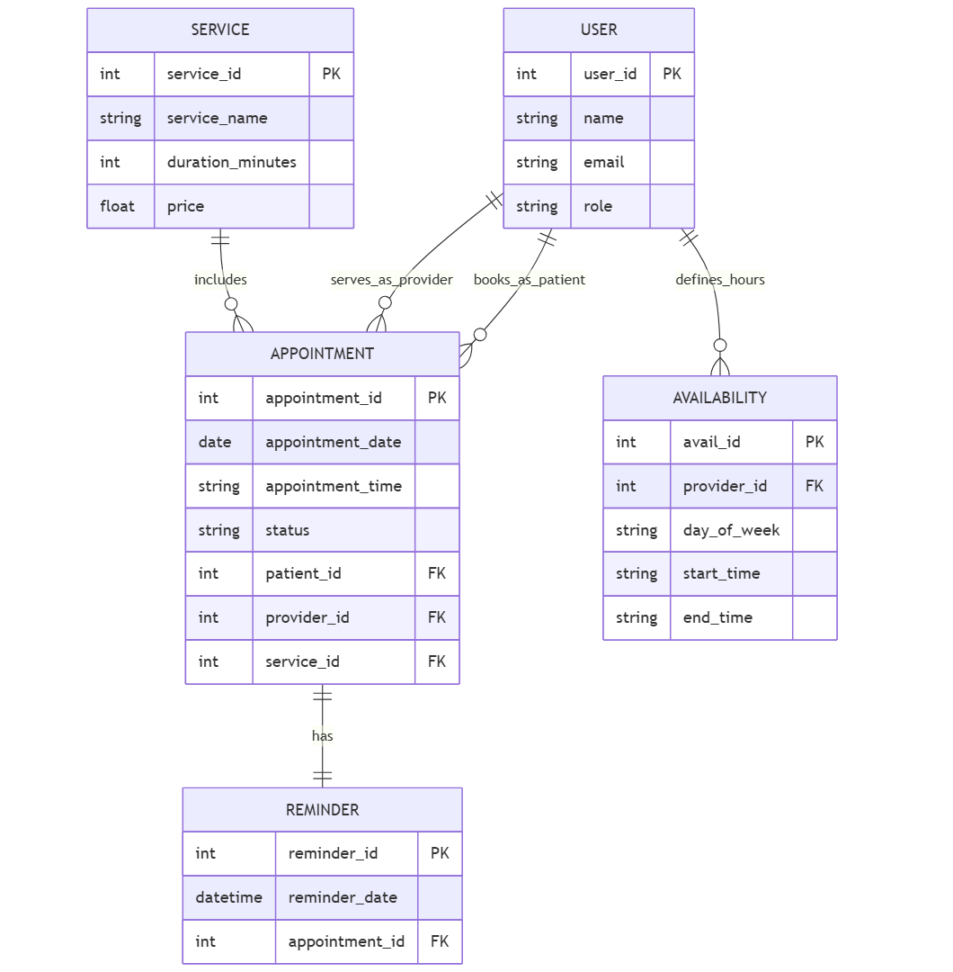
Project Objectives & Features
Objectives
Insert ER Diagram Screenshot Here
Automate appointment scheduling and management.
Enforce a strict 24-hour cancellation policy to improve operational efficiency.
Implement audit logging to ensure data integrity and traceability.
Key Features
User management for Patients, Providers, and Admins.
Service catalog management including checkups, cleanings, braces, etc.
Real-time tracking of appointment status and automated reminders.

Slide 4
Database Structure Overview
app_user
service
appointment
Manages user roles (Patient, Provider, Admin) and tracks email addresses.
Stores dental services offered along with pricing details.
Tracks bookings with status management for confirmation, cancellation, and completion.
availability
reminder
Records provider availability by day and time slots for accurate scheduling.
Manages 24-hour reminder notifications to reduce no-shows.

Slide 5
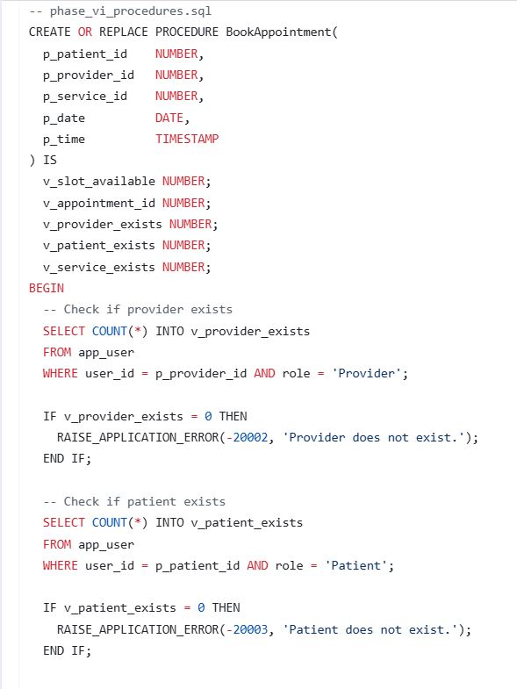



PL/SQL Procedures & Triggers
Procedure: BookAppointment
Trigger: trg_prevent_cancel
Validates appointment slot availability before inserting a new booking to prevent overlaps.
Prevents appointment cancellations within 24 hours of the scheduled time to enforce policy.
Trigger: trg_appointment_audit
Logs all INSERT, UPDATE, and DELETE operations on appointments ensuring full audit trails.

Slide 6
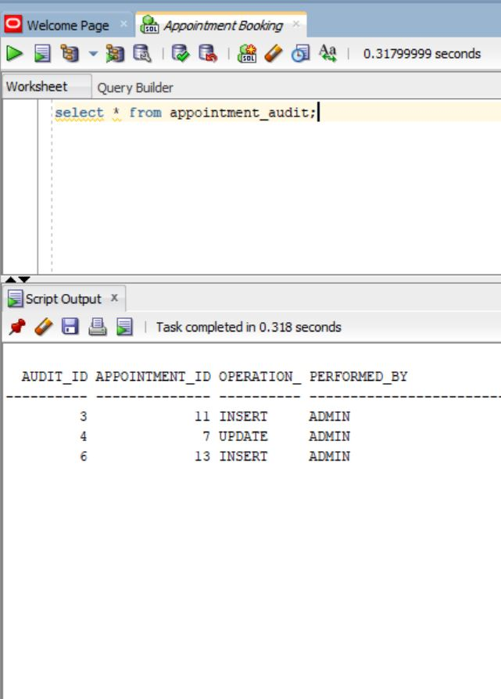
Auditing & Testing
1
Audit Table Overview
appointment_audit table captures changes with timestamps, user info, and action details.
2
Test Scenario 1
Insert appointment and verify corresponding audit record is generated accurately.
3
Test Scenario 2
Attempt cancellation within prohibition window and confirm error is thrown as intended.
4
Test Scenario 3
Update appointment status and validate audit log reflects the modification properly.

Slide 7
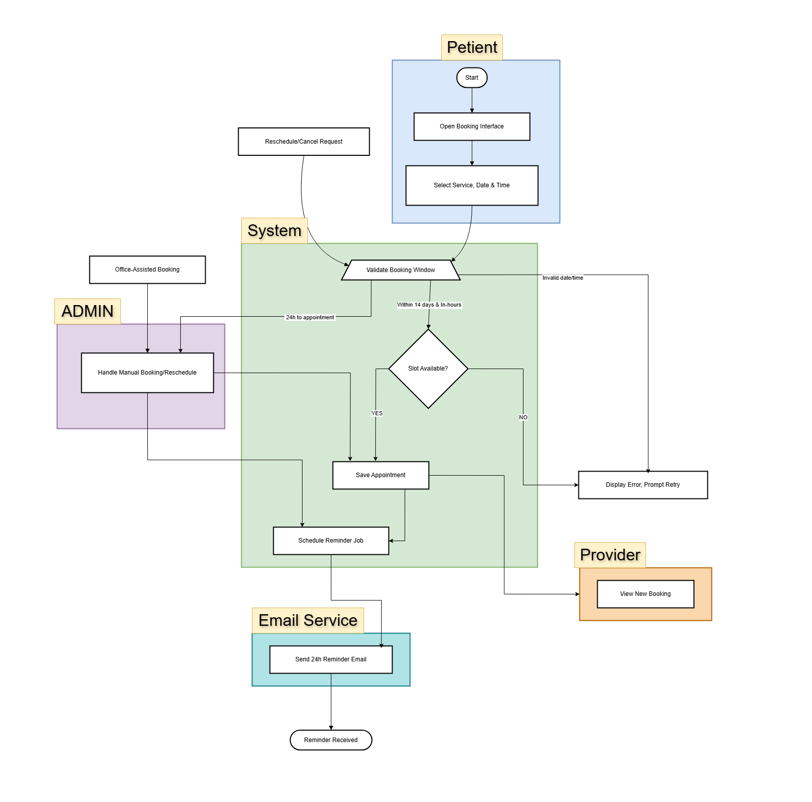
Conclusion & Future Enhancements
The Appointment Scheduling System successfully automates booking, enforces cancellation rules, and maintains comprehensive audit logs. This implementation significantly improves clinic operational efficiency and patient service reliability.
Insert Conclusion Graphic or Summary Chart Here
Future enhancements will include adding email notifications for reminders, developing an intuitive front-end interface for both patients and staff, and integrating data analytics to track provider performance and optimize scheduling.

Slide 8

Key Takeaways & Next Steps
System Impact
Automated scheduling reduces errors and administrative workload, enhancing patient satisfaction.
Policy Enforcement
Cancellation policies are strictly enforced through PL/SQL triggers, protecting clinic resources.
Audit Trail
Comprehensive audit logging ensures data integrity and accountability across all appointment changes.
Future Focus
Planned enhancements aim to boost usability and data-driven decision-making for clinic management.

Slide 9

Thank You! Questions?
Thank you for your attention. I invite any questions or discussions related to the Appointment Scheduling System or its development process.
Contact Information: Shema Christian
Email: shemachristian250@gmail.com

